Slide 1
Source:
E-Commerce: The Second Wave
Fifth Annual Edition
Chapter 8:
Web Server Hardware and Software

Slide 2
Objectives
In this chapter, you will learn about:
Web server basics
Software for Web servers
Internet utility programs
Web server hardware

Slide 3
Web Server Basics
Main job of a Web server computer
  To respond to requests from Web client computers
Three main elements of a Web server
  Hardware
  Operating system software
  Web server software

Slide 4
Types of Web Sites
Development sites
  Used to evaluate different Web designs
Intranets
  Corporate networks that house internal memos, corporate policy handbooks
Extranets
  Intranets that allow authorized parties outside the company to access information stored in the system

Slide 5
Types of Web Sites (Continued)
Transaction-processing sites
  Commerce sites that must be available 24 hours a day, seven days a week
Content-delivery sites
  Deliver content such as news, histories, summaries, and other digital information

Slide 6
Web Clients and Web Servers
Client/server architectures
  Client computers typically request services
  Server processes clients’ requests
Web software
  Lets different types of computers, running different operating systems, communicate

Slide 7
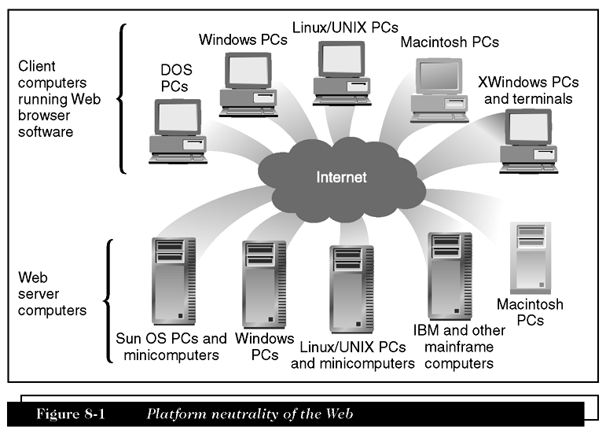
Platform Neutrality of the Web

Slide 8
Dynamic Content
Nonstatic information constructed in response to a Web client’s request
Dynamic page
  Web page whose content is shaped by a program in response to user requests
Static page
  An unchanging page retrieved from disk

Slide 9
Dynamic Content (Continued)
Server-side scripting
  Programs running on Web server create Web pages before sending them back to the requesting Web clients
Dynamic page-generation technologies
  Active Server Pages (ASP)
  JavaServer Pages (JSP)
  PHP: Hypertext Preprocessor (PHP)

Slide 10
Various Meanings of “Server”
Server
  Computer used to provide files or make programs available to other computers
Server software
  Used by server computer to make files and programs available to other computers
Database server
  Server computer on which database management software runs

Slide 11
Two-Tier Client/Server Architecture
Has only one client and one server
Request message
  Message that a Web client sends to request a file or files from a Web server
Typical request message
  Request line
  Optional request headers
  Optional entity body

Slide 12
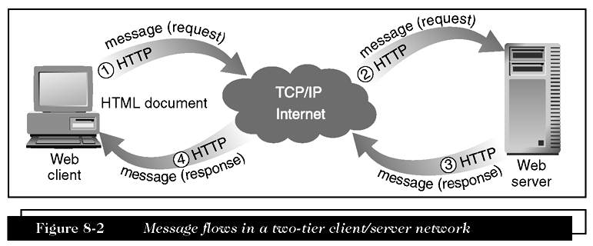
Message Flows in a Two-tier Client/Server Network

Slide 13
Two-Tier Client/Server Architecture (Continued)
Request line
  Contains command, name of target resource, and protocol name and version number
Request headers
  Can contain information about types of files that client will accept in response to request
Entity body
  Used to pass bulk information to the server

Slide 14
Two-Tier Client/Server Architecture (Continued)
Three-tier architecture
  Extends two-tier architecture to allow additional processing
N-tier architectures
  Higher-order architectures
  Third tier includes software applications that supply information to Web server

Slide 15
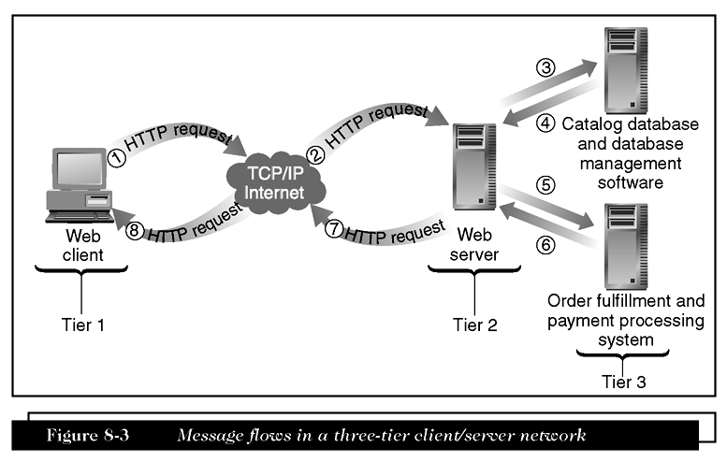
Message Flows in a Three-tier Client/Server Network

Slide 16
Software for Web Servers
Operating system tasks
  Running programs and allocating computer resources
Linux
  Open-source operating system that is easy to install, fast, and efficient
Open-source software
  Developed by community of programmers who make it available for download at no cost

Slide 17
Web Server Software
Most popular Web server programs
  Apache HTTP Server
  Microsoft Internet Information Server (IIS)
  Sun Java System Web Server (JSWS)
Let’s see a sample: Netcraft
  A networking consulting company in Bath, England
  Accumulated popularity rankings

Slide 18
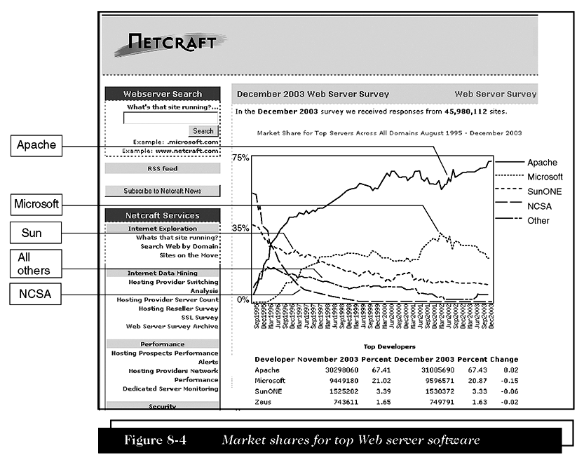
Market Shares for Top Web Server Software

Slide 19
Apache HTTP Server
Ongoing group software development effort
Dominated Web since 1996 because it is free and performs efficiently
Apache
  Developed by Rob McCool at University of Illinois in1994 at the NCSA
  Currently available on the Web at no cost as open-source software

Slide 20
Microsoft Internet Information Server
Comes bundled with current versions of Microsoft Windows Server operating systems
Used on many corporate intranets
Supports the use of
  ASP
  ActiveX Data Objects
  SQL database queries

Slide 21
Sun Java System Web Server
(Sun ONE, iPlanet, Netscape)
Descendant of original NCSA Web server program
Formerly sold under the names
  Sun ONE
  Netscape Enterprise Serve
  iPlanet Enterprise Server
Charges a $1500-per-CPU licensing fee

Slide 22
Web Site and Internet Utility Programs
Finger
  Runs on UNIX operating systems
  Allows users to obtain information about other network users
  Command yields list of users who are logged on to network
Ping (Packet Internet Groper)
  Tests connectivity between two computers connected to the Internet

Slide 23
Tracert and Other Route-Tracing Programs
Tracert (TRACE RouTe)
  Sends data packets to every computer on the path between one computer and another
  Clocks packets’ roundtrip times
  Calculate and display number of hops between computers
  Calculate time it takes to traverse entire one-way path between machines

Slide 24
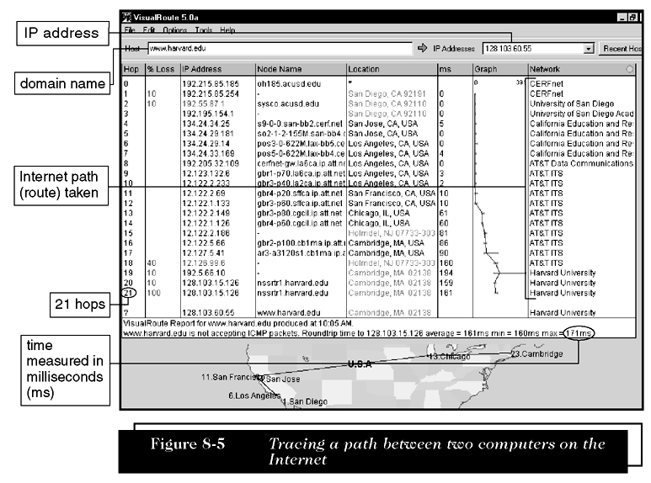
Tracing a Path Between Two Computers on the Internet

Slide 25
Electronic Mail
Useful feature
  Attachments
Drawbacks
  Time spent by business people responding to e-mail
  Computer virus
    Program that attaches itself to another program
    Can cause damage when host program is activated

Slide 26
Unsolicited Commercial E-Mail
(UCE, Spam)
Electronic junk mail that can include
  Solicitations, advertisements, or e-mail chain letters
Can consume large amounts of Internet capacity
Companies
  Now offer software to limit amount of spam

Slide 27
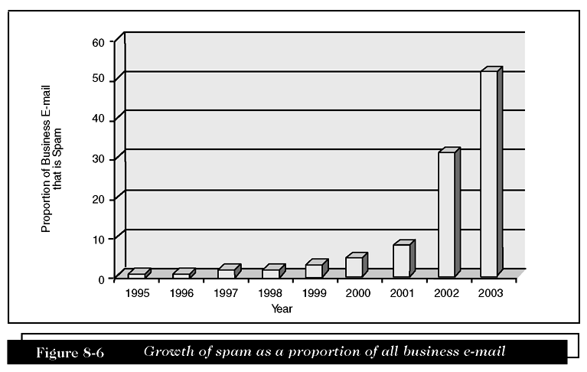
Growth of Spam as a Proportion of all Business E-mail

Slide 28
Solutions to the Spam Problem
Reduce likelihood that a spammer can automatically generate e-mail addresses
Control exposure of an e-mail address
Use multiple e-mail addresses
Content filtering strategy
  Require software that identifies content elements that indicate if message is (or is not) spam

Slide 29
Solutions to the Spam Problem (Continued)
Content-filtering techniques
  Black list spam filter
    Looks for known spammer From addresses in incoming messages
  White list spam filter
    Examines From addresses and compares them to list of known good sender addresses
  Challenge-response
    Compares all incoming messages to a white list

Slide 30
Telnet and FTP Utilities
Telnet
  Program that allows users to log on to a computer connected to the Internet
Telnet protocol
  Set of rules used by Telnet programs
File Transfer Protocol (FTP)
  Defines formats used to transfer files between TCP/IP-connected computers

Slide 31
Indexing and Searching Utility Programs
Search engines or search tools
  Search either a specific site or the entire Web for requested documents
Indexing program
  Can provide full-text indexing that generates an index for all documents stored on server
  Can often index documents stored in many different file formats

Slide 32
Data Analysis Software
Web servers can capture
  Data about who is visiting a Web site
  How long the visitor’s Web browser viewed site
  Date and time of each visit
  Which pages visitor viewed
Data captured by Web servers
  Stored in a log file

Slide 33
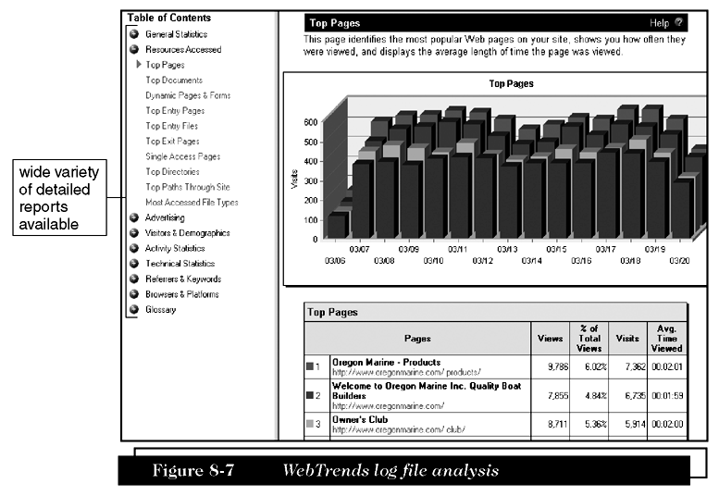
WebTrends Log File Analysis

Slide 34
Link-Checking Utilities
Link checker
  Examines each Web page and reports on URLs that are
    Broken, seem broken, or are in some way incorrect
Orphan file
  File on Web site not linked to any Page
Dead link
  When clicked, displays error message rather than a Web page

Slide 35
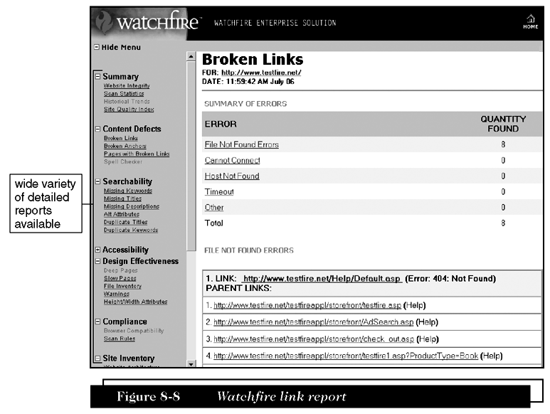
Watchfire Link Report

Slide 36
Remote Server Administration
Web site administrator can control Web site from any Internet-connected computer
NetMechanic
  Offers variety of link-checking, HTML troubleshooting, site-monitoring, and other programs

Slide 37
Web Server Hardware
Web server computers
  More memory, larger hard disk drives, and faster processors
Blade servers
  Placing small server computers on a single computer board, then installing boards into a rack-mounted frame
Virtual server (virtual host)
  Maintains more than one server on one machine

Slide 38
Web Server Performance Evaluation
Benchmarking
  Testing used to compare the performance of hardware and software
Throughput
  Number of HTTP requests that hardware and software combination can process in a unit of time
Response time
  Time required by server to process one request

Slide 39
Web Server Hardware Architectures
Server farms
  Large collections of servers
Centralized architecture
  Uses a few very large and fast computers
Distributed/decentralized architecture
  Uses large number of less powerful computers
  Divides the workload among them

Slide 40
Load-Balancing Systems
Load-balancing switch
  Piece of network hardware that monitors the workloads of servers attached to it
  Assigns incoming Web traffic to server that has the most available capacity at that instant in time

Slide 41
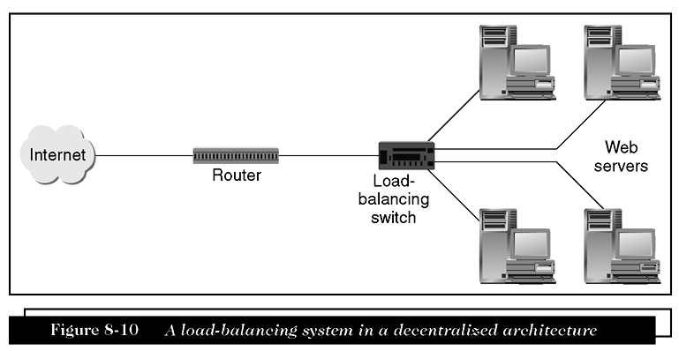
A Load-Balancing System in a Decentralized Architecture

Slide 42
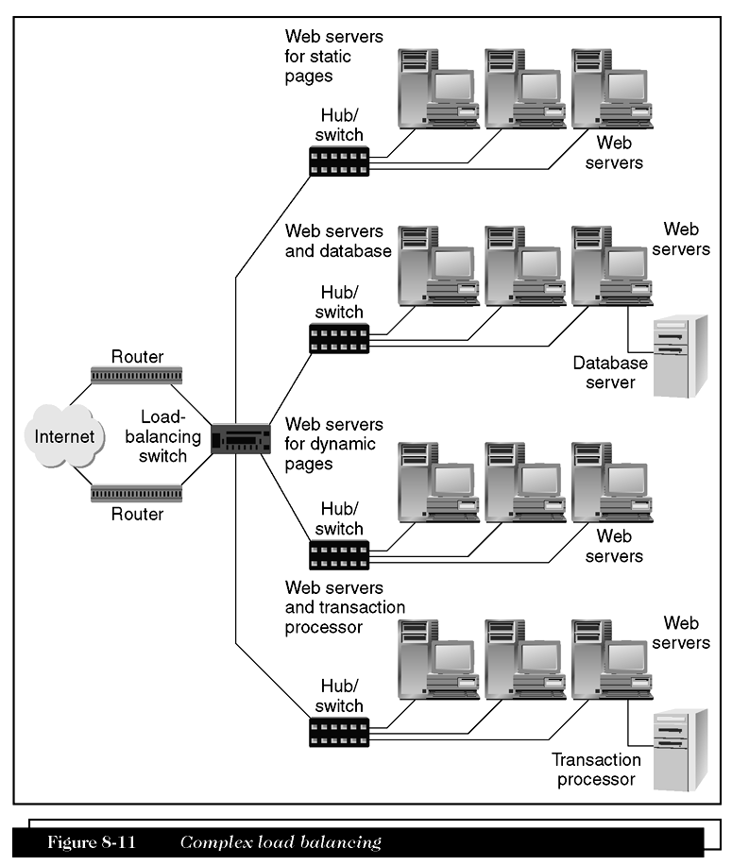
Complex Load Balancing

Slide 43
Summary
Web uses
  Client/server architecture
For simple HTTP requests
  Two-tier architecture works well
Operating systems commonly used on Web server computers
  Microsoft server operating systems
  UNIX-based operating systems

Slide 44
Summary
Utility programs running on Web server computers
  Finger, Ping, Tracert, email server software, Telnet, and FTP
Web server hardware
  Server computer must have enough memory and disk space
Factors that affect Web server performance
  Operating system
  Connection speed
  User capacity

